Slide 1
Impact of Covid-19 Pandemic on Air and Road Accidents
By Group 20
Lakshmi Keerthi Gopireddy
Aadesh Upadhyay
Siri Chandana Siripurapu
Sajid Ali Shaik

Slide 2

Objective of the project
Main aim of the project is to visualize and analyze the impact of Covid-19 lockdown or pandemic rules on air and land transportation.
Understand the correlation between Covid traffic regulations and accidents
Webpage to display the visualizations

Slide 3
Domain Introduction
Transportation safety domain is to ensure safety and decrease in accidents while travelling
Covid 19 regulations included transportation and mobility restrictions
Impact of these regulations on road and air transportation can be analysed to understand the need for change in traffic rules

Slide 4
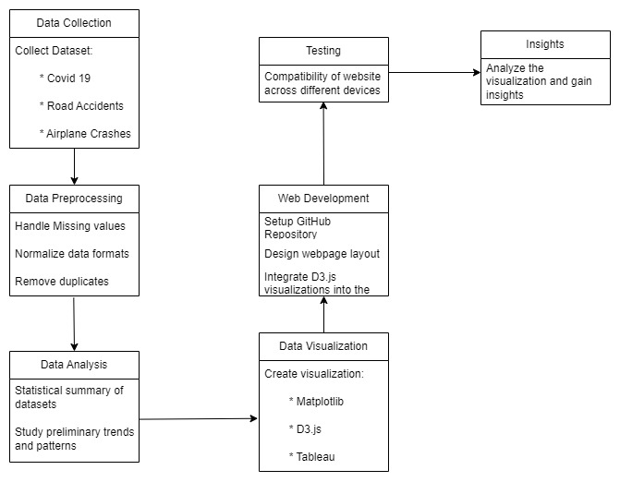
Project Workflow

Slide 5
Data Abstraction
Total number of Datasets used in this project is Three. They are:
Covid-19 stringency and cases data
This dataset contains information about the number of cases during Covid-19, stringency (strictness of regulations), GDP, deaths, vaccinations and population across multiple locations or countries
Road accidents data
This dataset contains details about road accidents during 2021 containing details about the accident severity, location, timings, road type, weather conditions, etc.
Airplane crashes data
This dataset contains details about airplane crashes from 1908 to 2023 emphasizing on the airplane type, flight number, route, fatalities, etc.
We have combined all the 3 datasets keeping the date as the merging column

Slide 6
Covid 19 Dataset
Attributes of Interest:
iso_code: Qualitative
continent : Catégorial
location : Qualitative
date: Quantitative
total_cases: Quantitative
new_cases : Quantitative
total_deaths : Quantitative
positive_rate : Quantitative
total_vaccinations : Quantitative
stringency_index : Quantitative
population : Quantitative
Life_expectancy: Quantitative
gdp_per_capita : Quantitative
extreme_poverty: Quantitative
cardiovasc_death_rate: Quantitative
Raw Data size:
Number of attributes: 67
Number of datapoints: 166326
Data Transformation:
Identifying and deleting columns which are unnecessary using domain knowledge
Deleting columns which are duplicate or have similar meaning
Checking the null values and dropping the columns with high null values
Total attributes after data transformation: 35
Notes:
Area of interest: 15 attributes

Slide 7
Road Accidents Dataset
Attributes of Interest:
Accident Date: Quantitative
Junction_Control: Qualitative
Accident_Severity: Categorical
Number_of_Casualties: Quantitative
Urban_or_Rural_Area: Categorical
Weather_Conditions: Categorical
Vehicle_Type: Qualitative
Location: Qualitative
Raw Data size:
Number of attributes: 21
Number of datapoints: 129889
Data Transformation:
Identifying and deleting columns which are unnecessary using domain knowledge
Deleting columns or rows which are duplicate or have similar meaning
Checking the null values and dropping the columns with high null values
Total attributes after data transformation: 17
Notes:
Area of interest: 8 attributes

Slide 8
Airplane Crashes Dataset
Attributes of Interest:
Date: Quantitative
Country: Qualitative
Operator: Categorical
Flight #: Qualitative
Route: Qualitative
Aboard: Quantitative
Fatalities: Quantitative
Fatalities Passengers: Quantitative
Fatalities Crew: Quantitative
Raw Data size:
Number of attributes: 17
Number of datapoints: 4998
Data Transformation:
Checking all columns for null values
Adding an additional column to capture country name from the location details
Total attributes after data transformation: 18
Notes:
Area of interest: 9 attributes

Slide 9
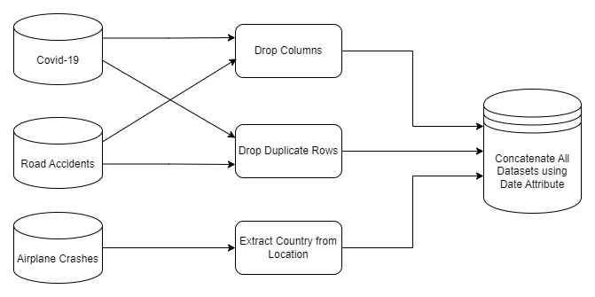
Workflow Diagram for Data Abstraction

Slide 10
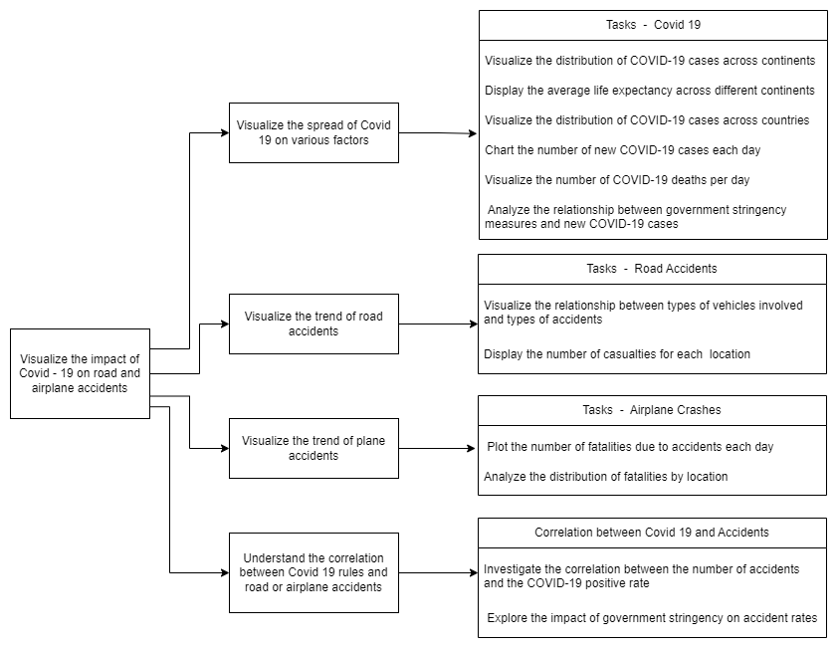
Workflow Diagram for Task Abstraction

Slide 11
Task Abstraction
Task | Target | Action
Visualize the distribution of COVID-19 cases across countries | Distribution of covid cases across countries | Analyze using a map
Visualize the distribution of COVID-19 across continents | Distribution of covid cases across continents | Analyze using a pie chart
Display the average life expectancy across different continents | Trends of life expectancy across continents | Analyze using a bar chart
Chart the number of new COVID-19 cases each day | Daily trend of covid cases | Analyze using a bar chart
Visualize the number of COVID-19 deaths per day | Day to Day trend of deaths due to covid | Analyze using a bar chart
Analyze the relationship between government stringency measures and new COVID-19 cases | Correlation between stringency index and covid cases | Analyze using scatter plot
Visualize the relationship between types of vehicles involved and types of accidents | Correlation between Accident type and Vehicle type | Analyze using a stacked chart
Display the number of casualties for each location | Distribution of road accident casualities per location | Analyze using a bar chart
Plot the number of fatalities due to accidents each day | Day to day trend of fatalities due to air crashes | Analyze using a line chart
Analyze the distribution of fatalities by location | Distribution of air crash fatalities across countries | Analyze using a map
Investigate the correlation between the number of accidents and the COVID-19 positive rate | Correlation between accidents and covid positive rate | Compare using multiple bar charts
Explore the impact of government stringency on accident rates | Correlation between stringency_index and number of accidents | Compare using multiple line charts

Slide 12
Implementation using Tools and Dataset
Visualization Name | Tools Used | Dataset Used
Total number of cases per country | Tableau | Covid_19.csv
Covid Cases Distribution by Continent | Python, Matplotlib | Covid_19.csv
Life Expectancy by Continent | Python, Matplotlib | Covid_19.csv
Number of new cases per day | Tableau | Covid_19.csv
Number of deaths per day | Tableau | Covid_19.csv
Stringency Index vs New Covid 19 cases | Vizhub, D3.js | Covid_19.csv
Accident type vs Vehicle type | Vizhub, D3.js | Road_Accidents.csv
Number of causalities reported per location | Vizhub, D3.js | Road_Accidents.csv
Number of fatalities per day | Tableau | Airplane_crash.csv
Number of fatalities in each location | Tableau | Airplane_crash.csv
No. of accidents vs covid positive rate | Tableau | Covid_19.csv, Airplane_crash.csv, Road_Accidents.csv
stringency_index vs number of accidents | Tableau | Road_Accidents.csv, Covid_19.csv

Slide 13
Description of Tools
Tableau:
Tableau is a data visualization tool which enables a user friendly environment with drag and drop options and multiple graph types. We can create multiple types of graphs using the tool and share it on public tableau. This contains maps and other complex graphs.
Matplotlib:
This is a library used to create visualizations using python programming language in Jupyter notebook. This a useful tool to create visualizations after performing data cleaning in the notebook. We can change every detail in the graph by code changes.
D3.js:
Data-driven documents is a JavaScript library used for creating interactive visualizations in web browsers. It uses html, css and svg to create visualisations. This is mainly used for directly displaying the data driven visualizations in webpages.

Slide 14
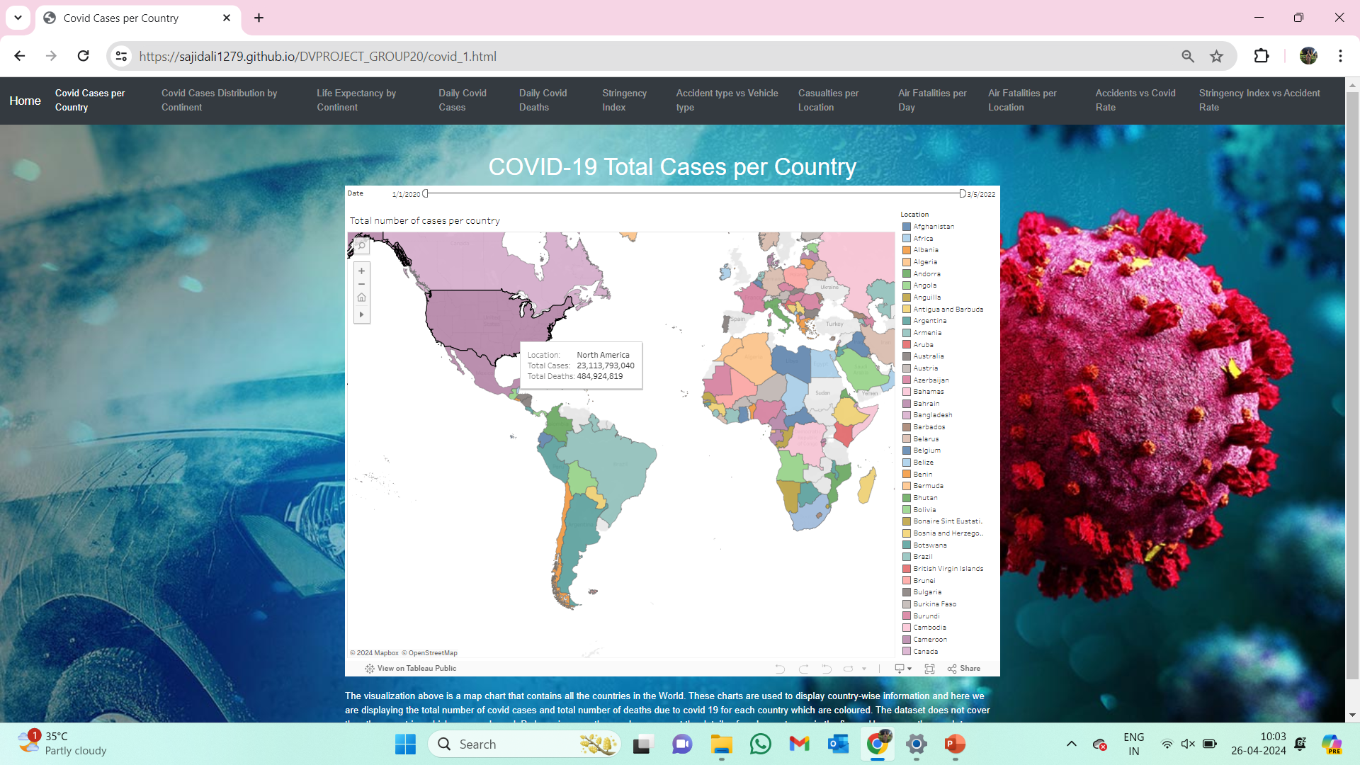
Visualization 1: Total number of cases per country
Notes:
The visualization above is a map chart that contains all the countries in the World. These charts are used to display country-wise information and here we are displaying the total number of covid cases and total number of deaths due to covid 19 for each country which are coloured. The dataset does not cover the other countries which are uncoloured. By hovering over the graph we can get the details of each country are in the figure.

Slide 15
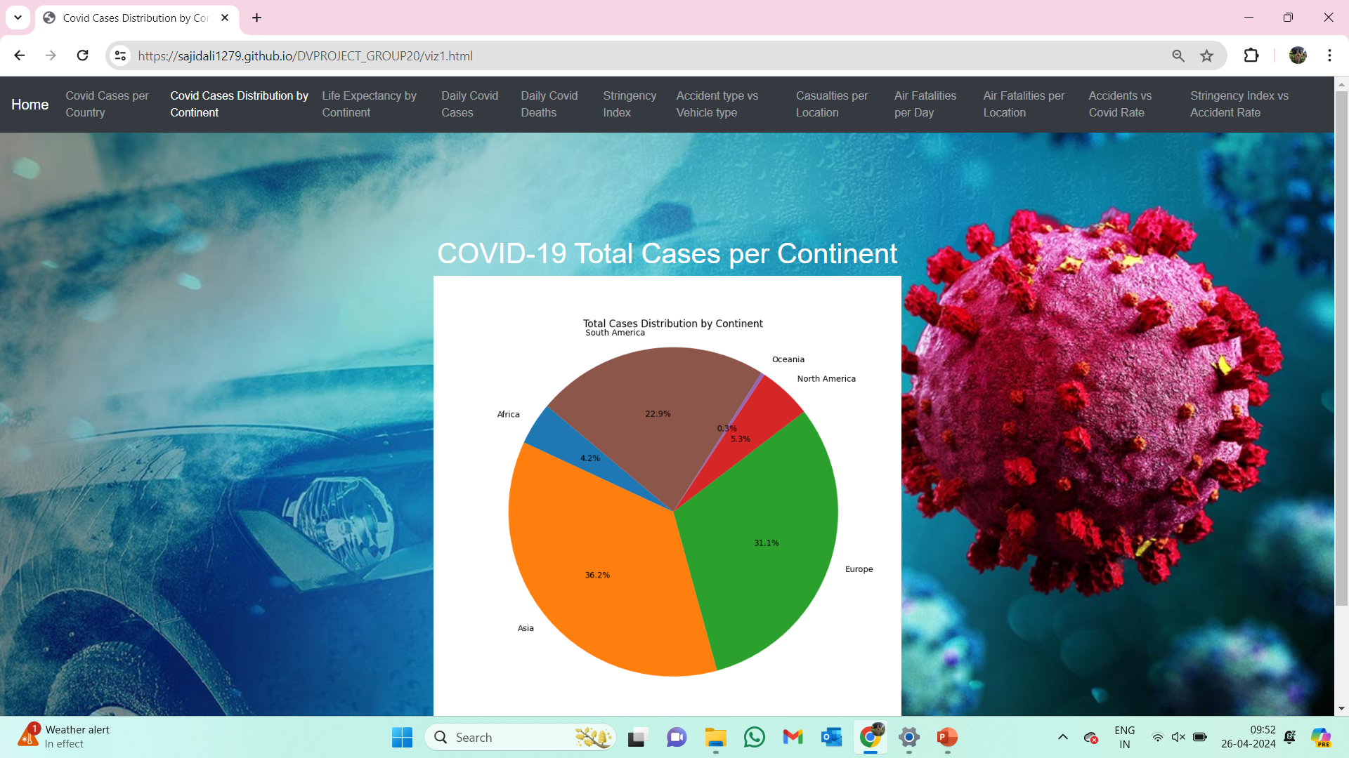
Visualization 2 : Total Cases Distribution by Continent
Notes:
This visualization is a pie chart which is generally used to display and analyze the distribution of any kind of data. As we have 7 continents, pie chart is useful to display the distribution of total covid cases till date (last day in the dataset) across all continents. From the graph, we can see that Asia is having the highest number of cases followed by Europe and the lowest is Oceania (Australia). We can see that the percentages are visible on the graph for each region. We can also observe that the number of cases in Asia and Europe cover more than 50% of the total cases in the world.

Slide 16
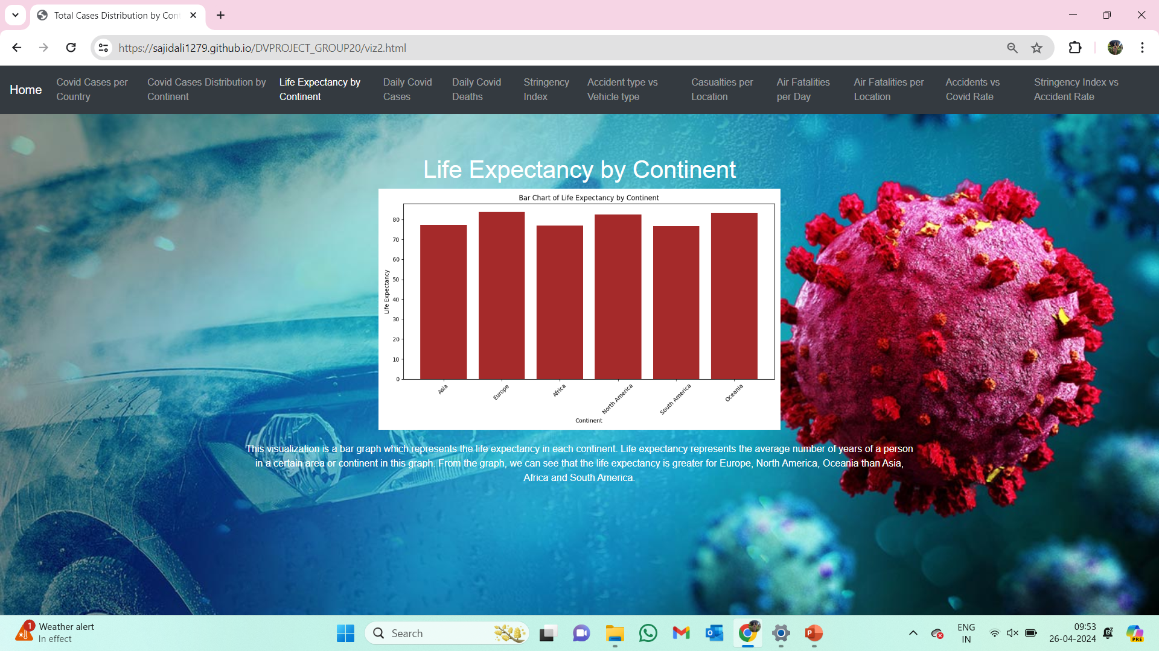
Visualization 3: Life Expectancy by Continent
Notes:
This visualization is a bar graph which represents the life expectancy in each continent. Life expectancy represents the average number of years of a person in a certain area or continent in this graph. From the graph, we can see that the life expectancy is greater for Europe, North America, Oceania than Asia, Africa and South America.

Slide 17
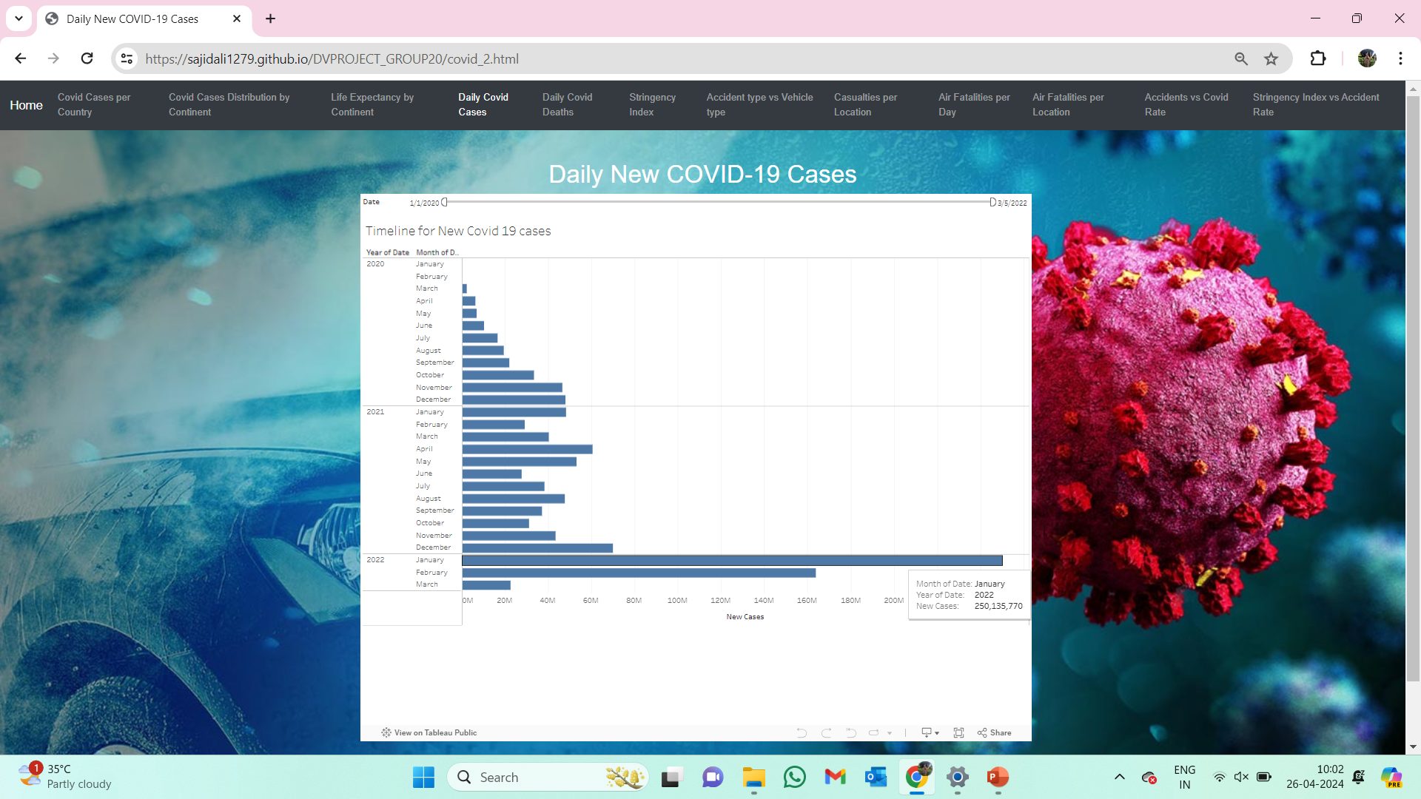
Visualization 4: Number of new cases per day
Notes:
The above graph is a horizontal bar graph with date, month and year on y-axis and number of new cases in x-axis. We can see that the timeline is from January 2020 to March 2022 and can be expanded into days if needed. For comparison in months, we are considering the timeline to be divided into months and the highest number of new cases can be observed in January 2022.By hovering over the graph, we can get the exact number of cases for example, in January 2022, total number of new cases are 250,135,770.

Slide 18
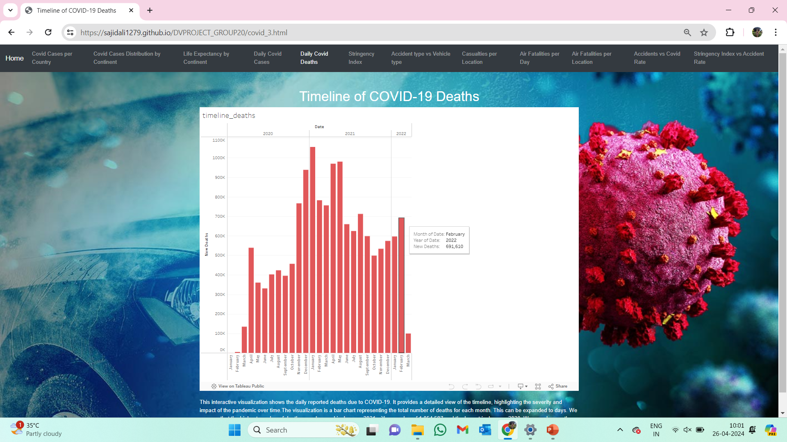
Visualization 5: Number of deaths per day
Notes:
The visualization is a bar chart representing the total number of deaths for each month. This can be expanded to days. We can see that the highest number of deaths are observed in January 2021 with a number of 1,054,587 and the lowest in January 2020. We can observe the spike in the covid deaths during November 2020.

Slide 19
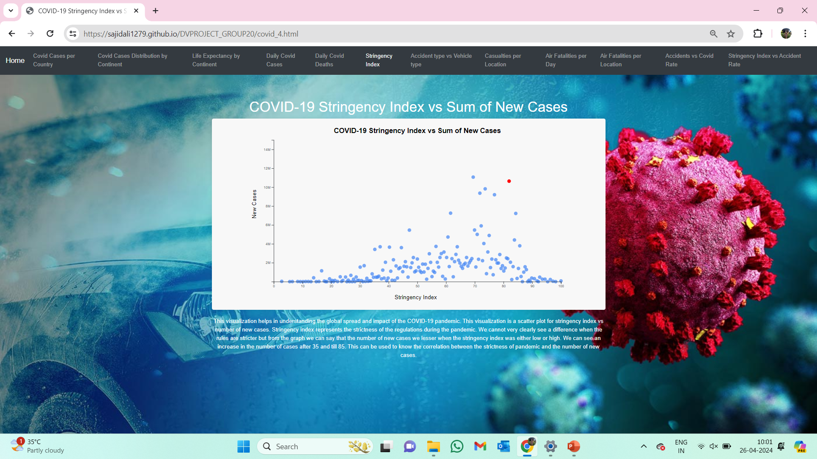
Visualization 6: Stringency Index vs New Covid 19 cases
Notes:
This visualization is a scatter plot for stringency index vs number of new cases. Stringency index represents the strictness of the regulations during the pandemic. We cannot very clearly see a difference when the rules are stricter but from the graph we can say that the number of new cases we lesser when the stringency index was either low or high. We can see an increase in the number of cases after 35 and till 85. This can be used to know the correlation between the strictness of pandemic and the number of new cases.

Slide 20
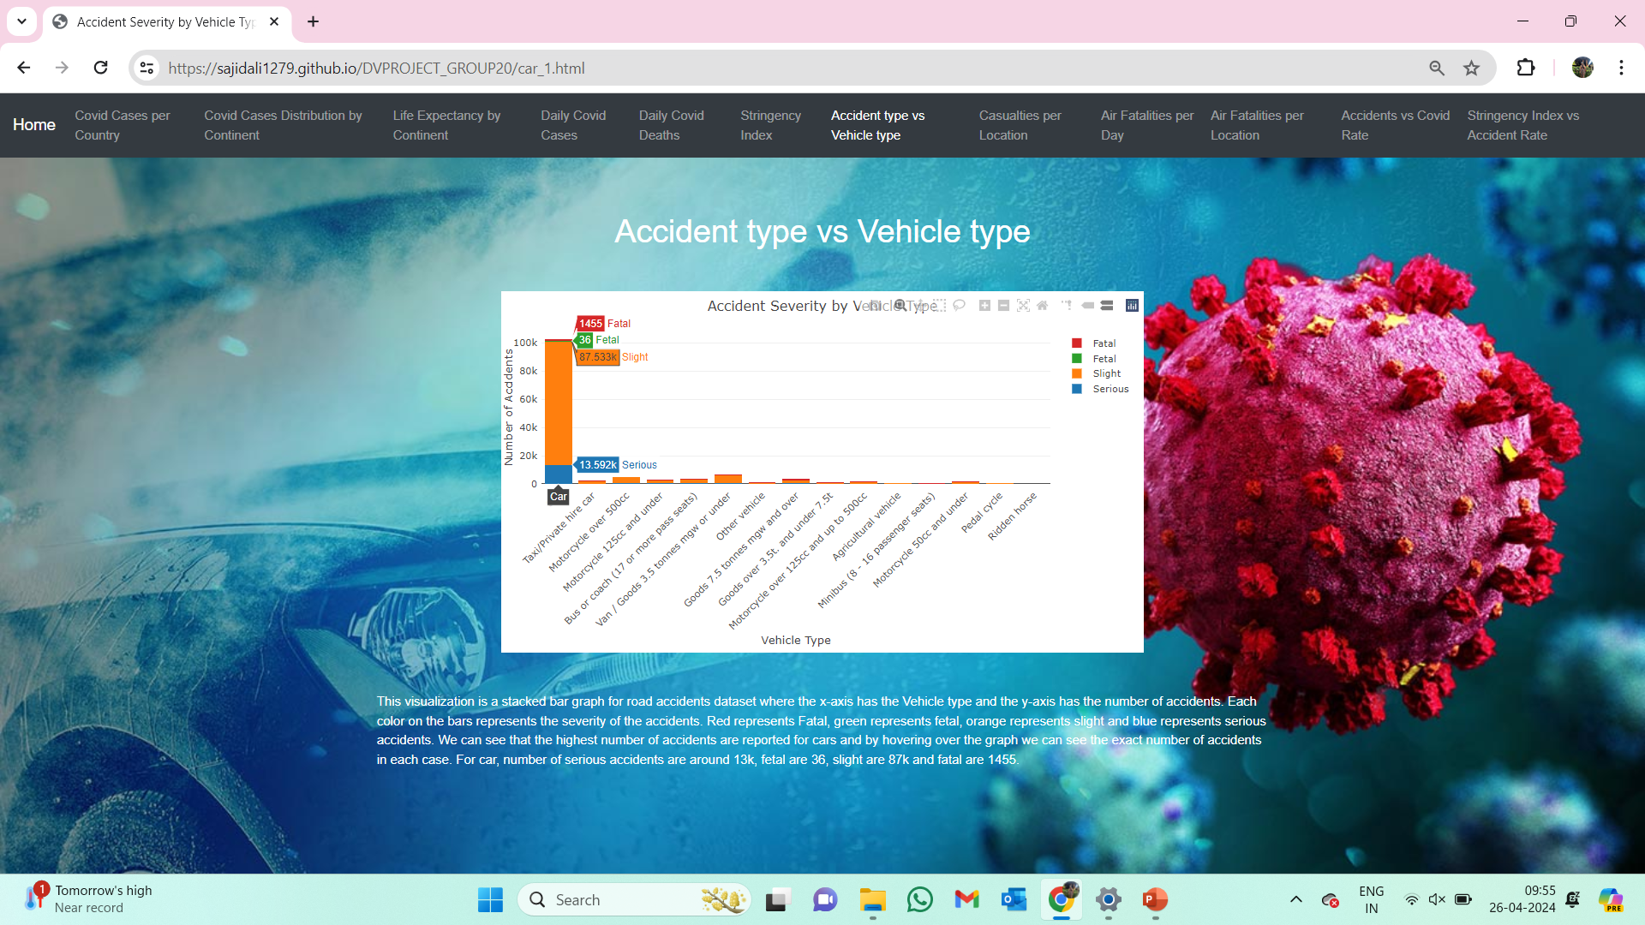
Visualization 7: Accident type vs Vehicle type
Notes:
This visualization is a stacked bar graph for road accidents dataset where the x-axis has the Vehicle type and the y-axis has the number of accidents. Each color on the bars represents the severity of the accidents. Red represents Fatal, green represents fetal, orange represents slight and blue represents serious accidents. We can see that the highest number of accidents are reported for cars and by hovering over the graph we can see the exact number of accidents in each case. For car, number of serious accidents are around 13k, fetal are 36, slight are 87k and fatal are 1455.

Slide 21
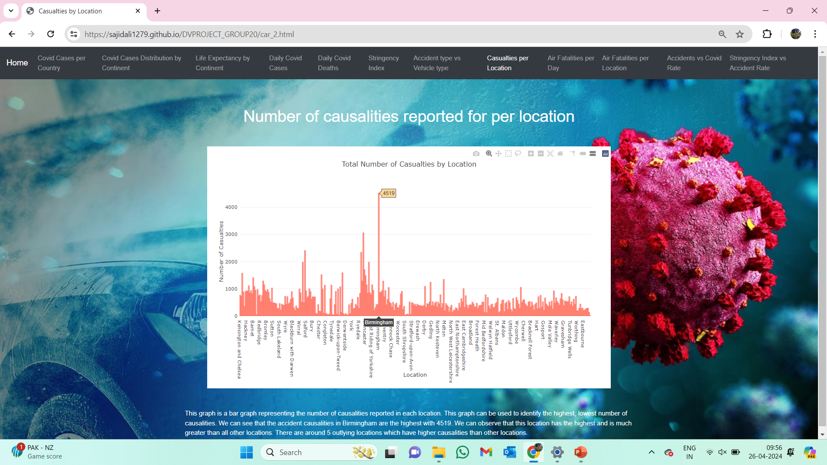
Visualization 8: Number of causalities reported for per location
Notes:
This graph is a bar graph representing the number of causalities reported in each location. This graph can be used to identify the highest, lowest number of causalities. We can see that the accident causalities in Birmingham are the highest with 4519. We can observe that this location has the highest and is much greater than all other locations. There are around 5 outlying locations which have higher causalities than other locations.

Slide 22
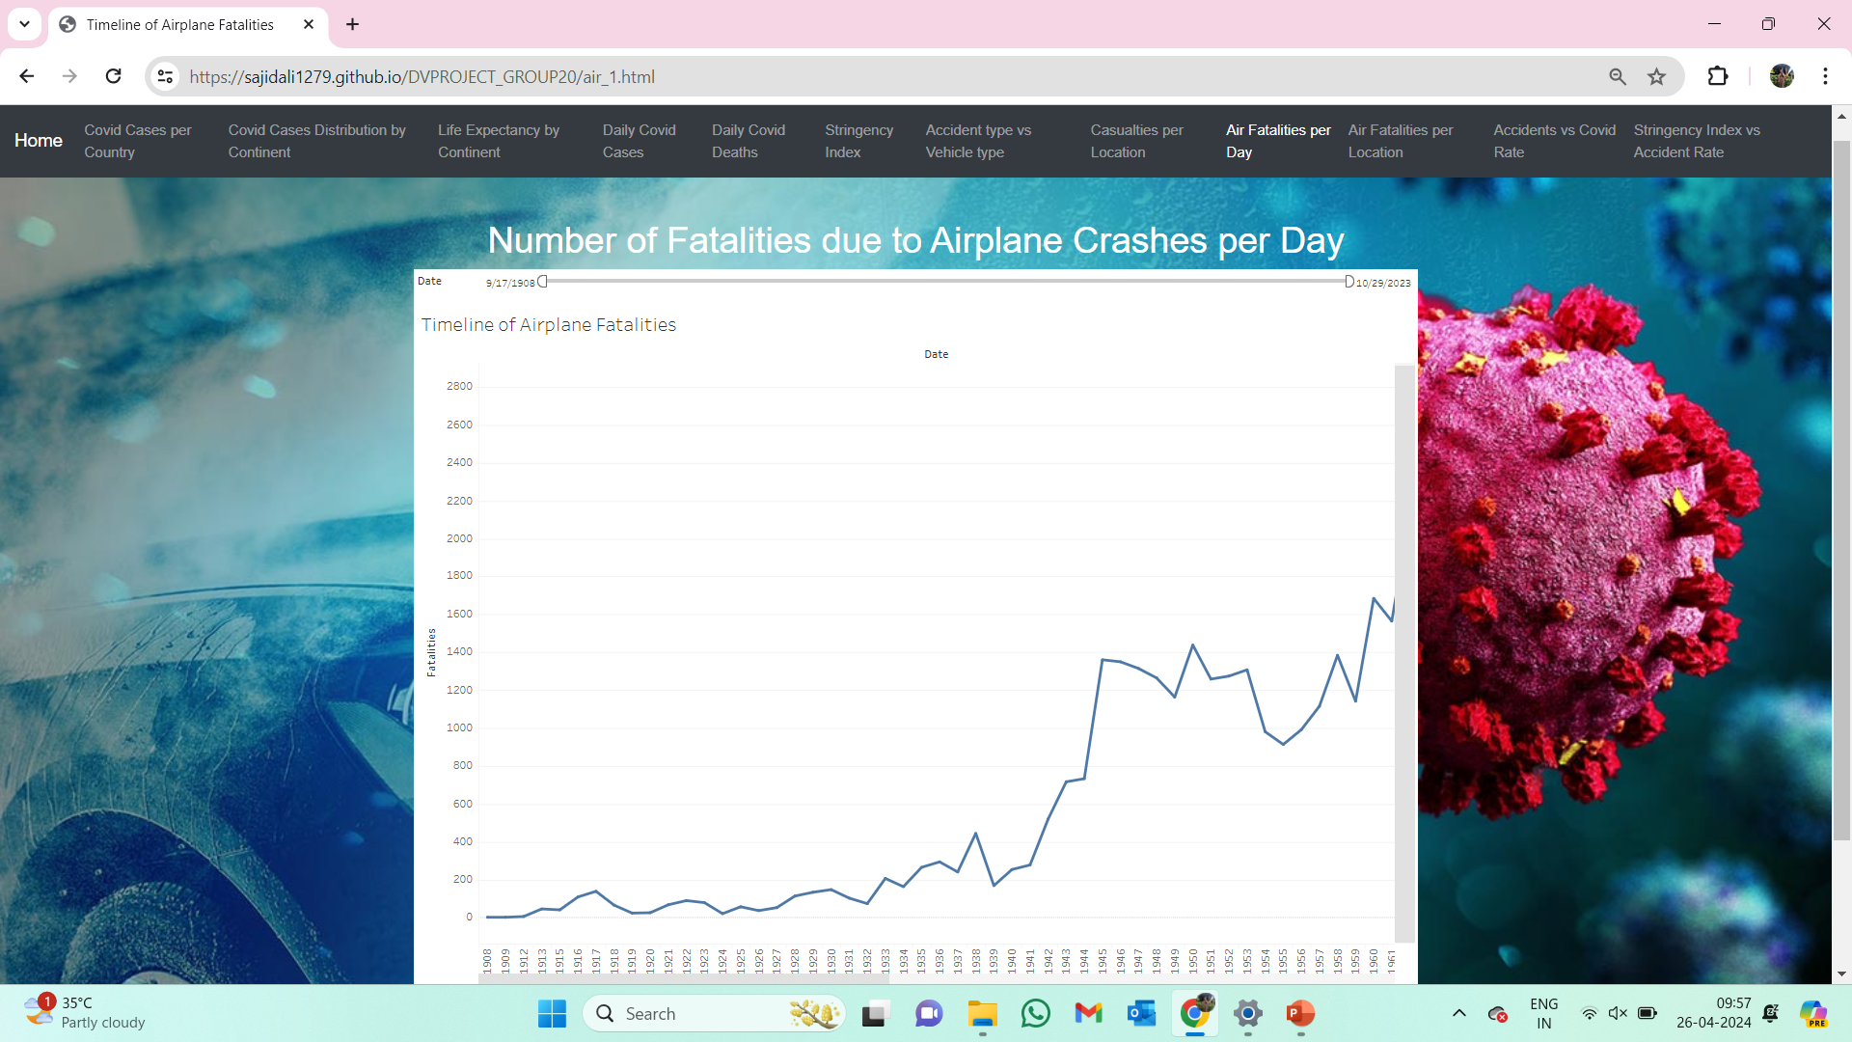
Visualization 9: Number of fatalities per day
Notes:
This visualization is a line graph containing information about the number of fatalities in airplane crashes from 1908 to 2023. We can observe the trend of fatalities by using the above graph. We can see that the number of fatalities is low till 1940 and then we see a spike in the number of cases. We can analyze the trend of fatalities across the years provided and the area of interest for is during the pandemic. By hovering over the graph, we can get the number of fatalities in each year, for example in 1945 the number of fatalities are 1360.

Slide 23
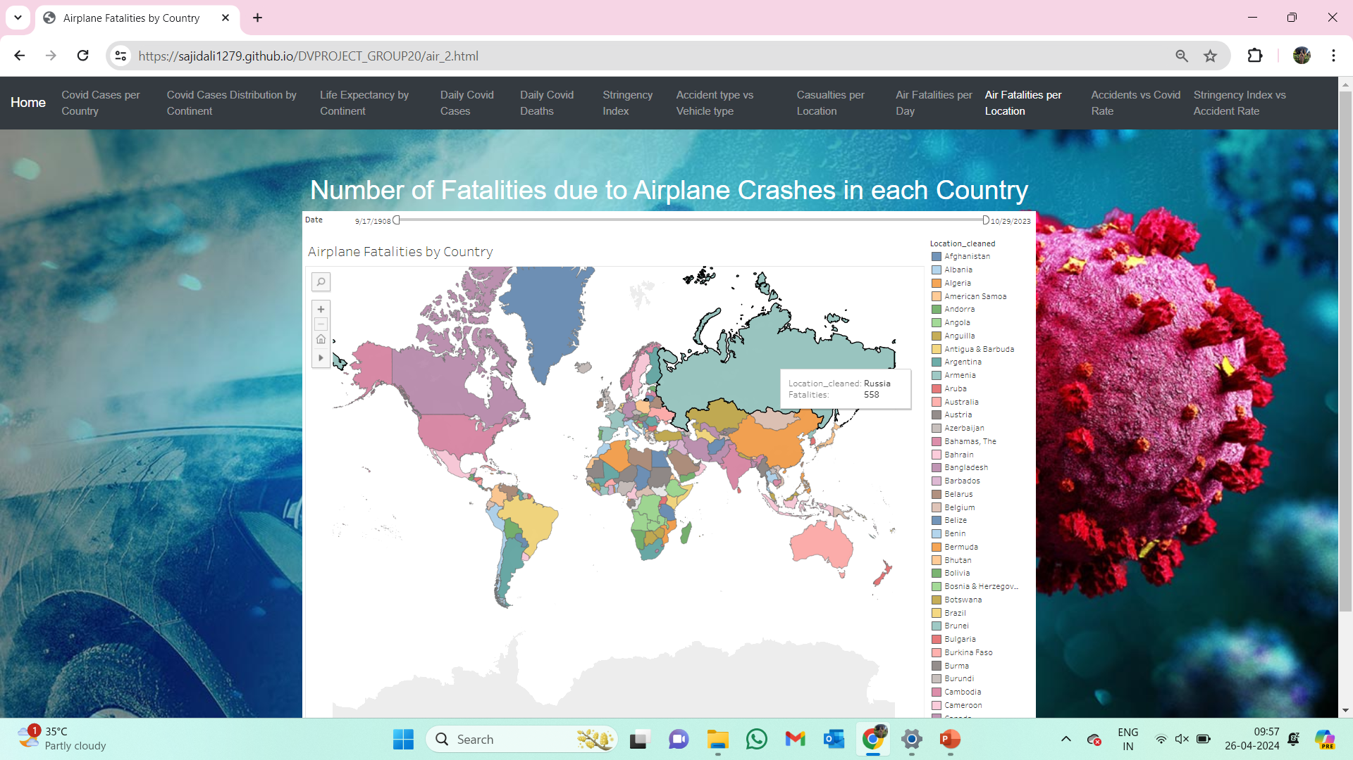
Visualization 10: Number of fatalities in each location
Notes:
This visualization is a map which represents the number of fatalities due to airplane crashes for each country over the period. For each location coloured in the graph, we have the number of fatalities and this can be obtained by hovering over the graph. For example, Russia is represented in pale teal color and the total number of fatalities are 558. We can get the fatalities for each country and can be useful for further analysis.

Slide 24
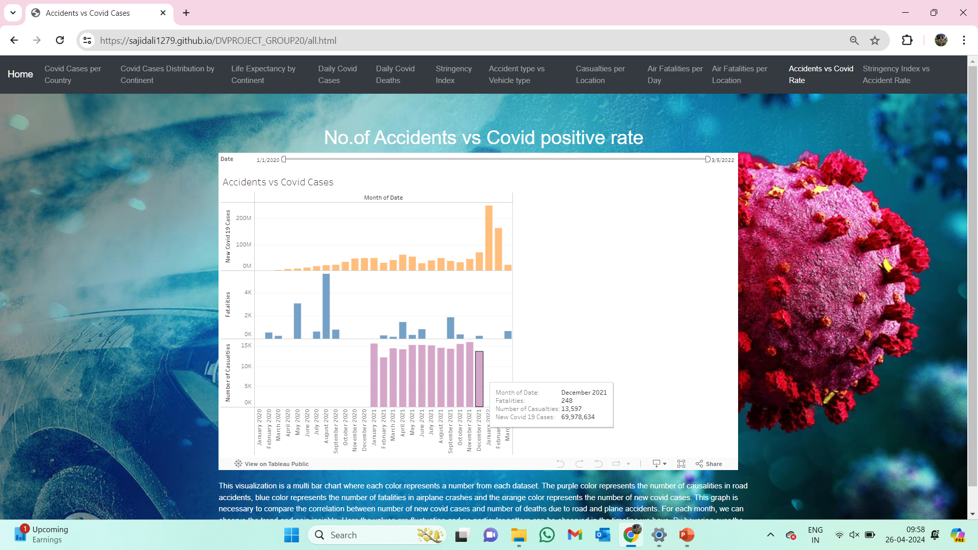
Visualization 11: No. of accidents vs covid positive rate
Notes:
This visualization is a multi bar chart where each color represents a number from each dataset. The purple color represents the number of causalities in road accidents, blue color represents the number of fatalities in airplane crashes and the orange color represents the number of new covid cases. This graph is necessary to compare the correlation between number of new covid cases and number of deaths due to road and plane accidents. For each month, we can observe the trend and gain insights. Here the values are fluctuating and no particular pattern can be observed in the timeline we have. By hovering over the graph, we can get the exact numbers.

Slide 25
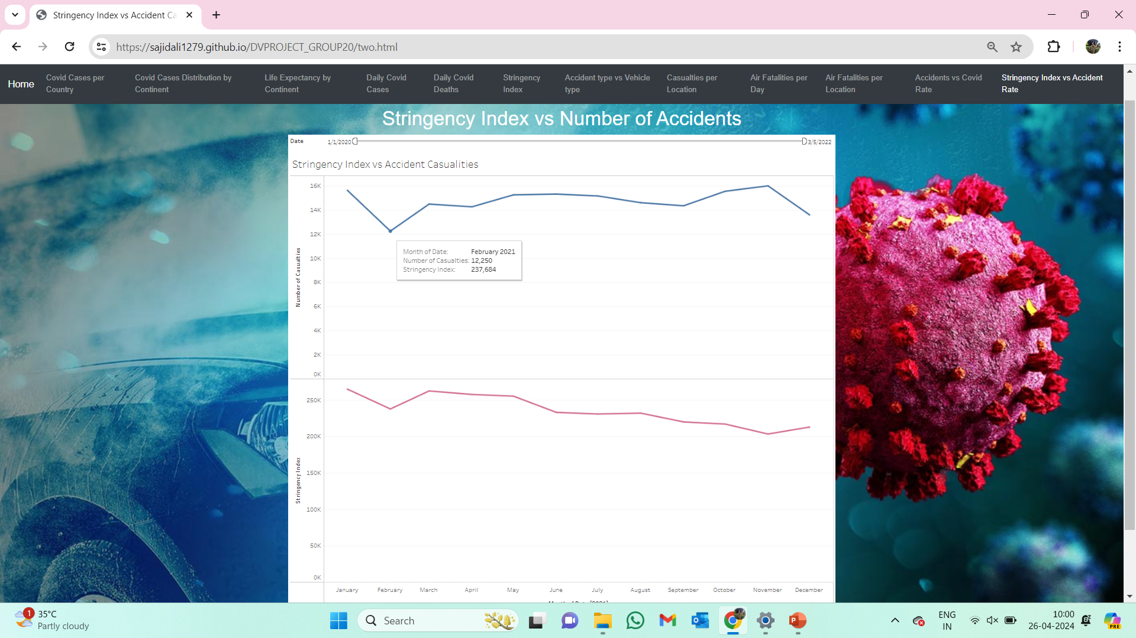
Visualization 12: Stringency index vs number of accidents
Notes:
This graph is multi line graph where each color represents a number or trend. Blue color represents the number of causalities and purple color represents the stringency index. Using this we can observe whether there is any correlation between stringency index and the number of causalities. We do not observe any particular pattern but at some places we can see that when the strigency index is dropped the number of causalities dropped.

Slide 26
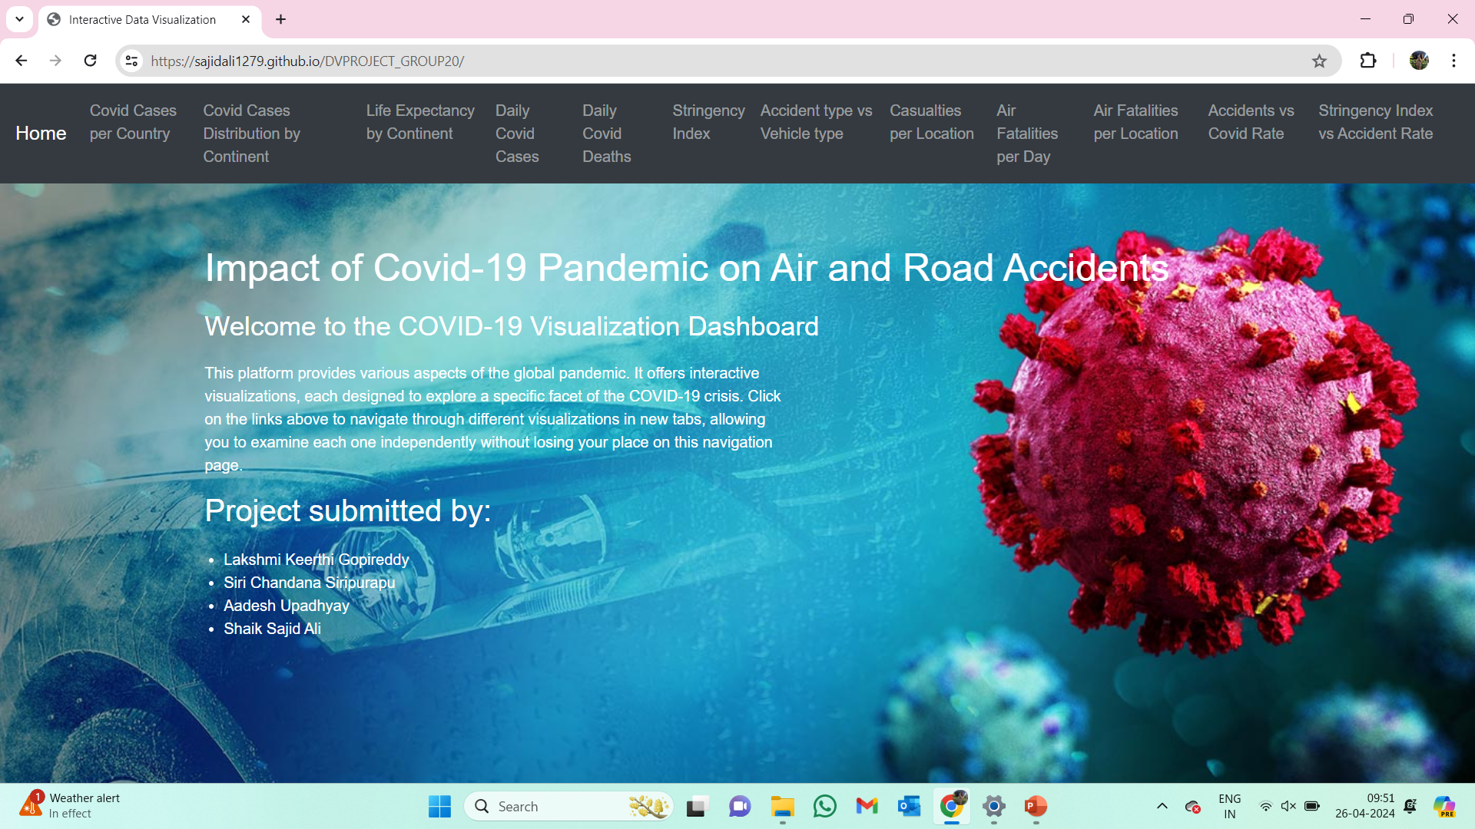
Webpage For Presentation

Slide 27
Implementation Status Report
Feature | Description | Responsibility | Contribution
Data Understanding | Collect Dataset and Understand the Dataset | All 4 of them | 25% Each
Data Preprocessing | Covid_19 Dataset | Lakshmi Keerthi & Sajid Shaik | 50% Each
 | Road Accidents Dataset | Aadesh Upadhyay | 100%
 | Airplane Crashes Dataset | Siri Chandana | 100%
Data Analysis | Basic analysis of the Pre-Processed Dataset | All 4 of them | 25% Each
Data Visualization | Visualization 1,2,3 | Aadesh Upadhyay | 100%
 | Visualization 4,5,6 | Siri Chandana | 100%
 | Visualization 7,8,9 | Sajid Shaik | 100%
 | Visualization 10,11,12 | Lakshmi Keerthi | 100%
Web Development | Setting up Github Repository | Aadesh Upadhyay and Sajid Shaik | 50% Each
 | WebPage Design | Lakshmi Keerthi and Siri Chandana | 50% Each
 | Integerate D3.Js | Aadesh Upadhyay and Siri Chandana | 50% Each
Testing and Deployment | Checking if the website works across multiple devices | Sajid Shaik | 100%
 | Make final edits and Deploy to GitHub pages | Lakshmi Keerthi | 100%
Power Point Presentation | Creating Powerpoint Presentation | All 4 of them | 25% Each

Slide 28
Links to Visualizations
Dataset | Possible visualizations | Links
Covid | Total number of cases per country | Link
Covid | Covid Cases Distribution by Continent | Link
Covid | Life Expectancy by Continent | Link
Covid | Number of new cases per day | Link
Covid | Number of deaths per day | Link
Covid | Stringency Index vs New Covid 19 cases | Link
Car Accidents | Accident type vs Vehicle type | Link
Car Accidents | Number of casualities reported for accident type/ per location | Link
Plane Accidents | Number of fatalities per day | Link
Plane Accidents | Number of fatalities in each location | Link
All | No. of accidents vs covid positive rate | Link
Two | stringency_index vs number of accidents | Link

Slide 29
Our Team Presentation Link:
https://unt.zoom.us/rec/share/l7nmji1duqa1hLimX6248ff1Co7tS1k41hzG-hT43v02LiEfLkm-ddjOwDHJpKSn.9zPPxRqy8v0ShMuo?startTime=1714183811000

Slide 30
References
We have cited some academic papers below which are related to the dataset that we have taken. This will help us as we are trying to perform analysis on our dataset.
[1] K. Shaaban and M. Mortimer, "The COVID-19 Pandemic’s Impact on Traffic Fatalities in Utah," 2022 Intermountain Engineering, Technology and Computing (IETC), Orem, UT, USA, 2022, pp. 1-4, doi: 10.1109/IETC54973.2022.9796727.
[2] N. Abdelfattah and M. Bahramipanah, "Impact of COVID-19 on Mobility and trafficVolume trends in Montana and California," 2021 IEEE International Smart Cities Conference (ISC2), Manchester, United Kingdom, 2021
[3] Ebrahim Shaik M, Ahmed S. An overview of the impact of COVID-19 on road traffic safety and travel behavior. Transportation Engineering. 2022 Sep;9:100119. doi: 10.1016/j.treng.2022.100119. Epub 2022 May 21. PMCID: PMC9123801.
[4] Òscar Saladié, Edgar Bustamante, Aaron Gutiérrez, COVID-19 lockdown and reduction of traffic accidents in Tarragona province, Spain, Transportation Research Interdisciplinary Perspectives, Volume 8, 2020, 100218, ISSN 2590-1982, https://doi.org/10.1016/j.trip.2020.100218.(https://www.sciencedirect.com/science/article /pii/S2590198220301299)
[5] https://www.ncbi.nlm.nih.gov/pmc/articles/PMC8157209

Slide 31
THANK YOU

